Slide 1





Analyzing sales data by performing different queries in SQL.
PRESENTED BY : SAYYED NIDA
CoHort 4

Slide 2





About Amazon
01
Amazon is a multinational technology company based in the United States, founded by Jeff Bezos in 1994. Initially an online bookstore, it has grown into one of the world's largest e-commerce, cloud computing, digital streaming, and artificial intelligence companies. Headquartered in Seattle, Washington, Amazon is known for its customer-centric approach, vast product selection, and innovative services like Amazon Prime, AWS (Amazon Web Services), and Alexa. It is one of the "Big Tech" companies alongside Apple, Microsoft, Google, and Meta, with a strong presence in global markets.

Slide 3


Queries to solve
02
1.List all products with a discounted price below ₹500.
2. Find products with a discount percentage of 50% or more.
3.Retrieve all products where the name contains the word "Cable."
4.Display the difference between the average of the actual price and the discounted price for each product.
5.Query reviews that mention "fast charging" in their content.
6.Identify products with a discount percentage between 20% and 40%.
7.Find products that have an actual price above ₹1,000 and are rated 4 stars or above.
8.Find products where the discounted price ends with a 9
9.Display review contents that contains words like worst, waste, poor, or not good.
10.List all products where the category includes "Accessories."

Slide 4
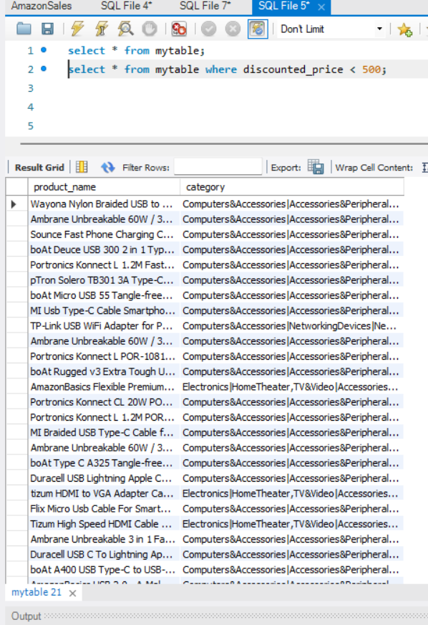
03
List all products with a discounted price
below ₹500.
select * from mytable where discounted_price < 500;

Slide 5
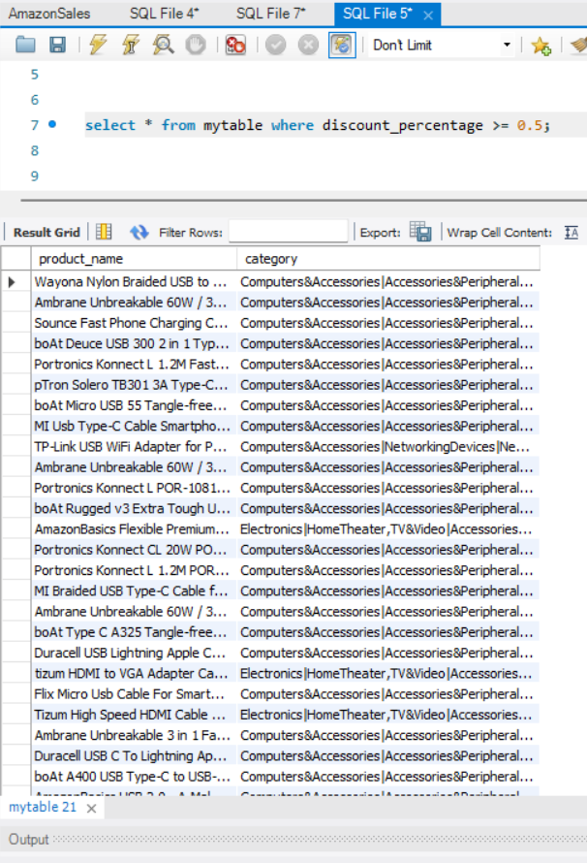
04
2.Find products with a discount percentage of 50% or more.
select * from mytable where discount_percentage
>= 0.5;

Slide 6
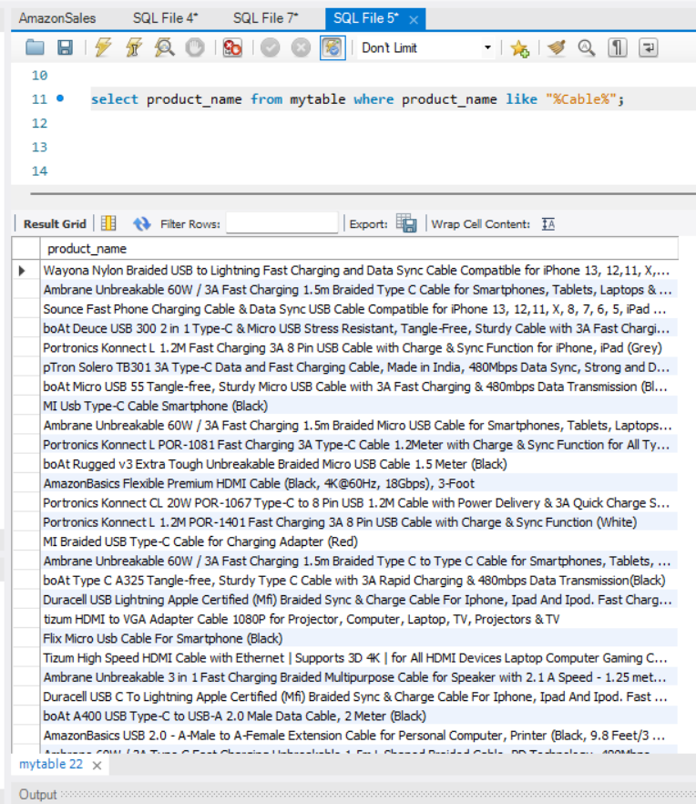
05
3. Retrieve all products where the name contains the word "Cable."
select product_name from mytable where product_name like "%Cable%";

Slide 7
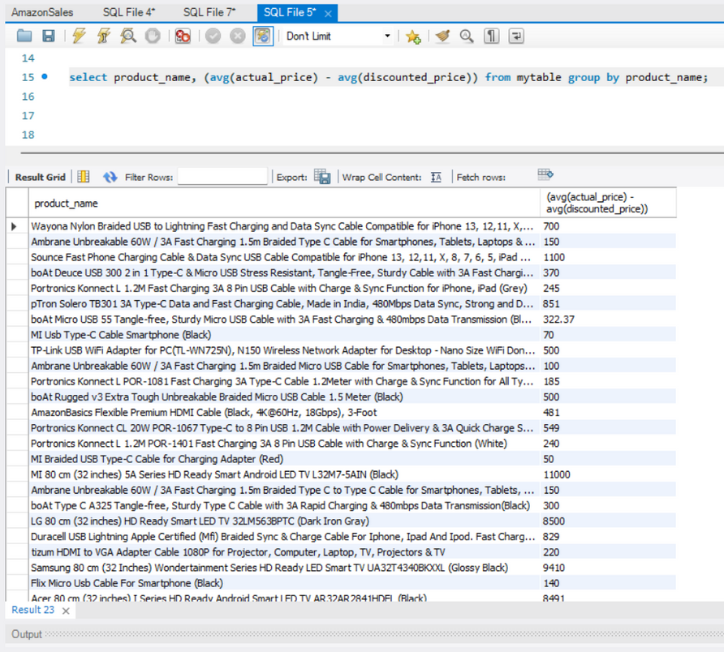
06
4.Display the difference between the average of the actual price and the discounted price for each product.
select product_name, (avg(actual_price) - avg(discounted_price)) from mytable group by product_name;

Slide 8
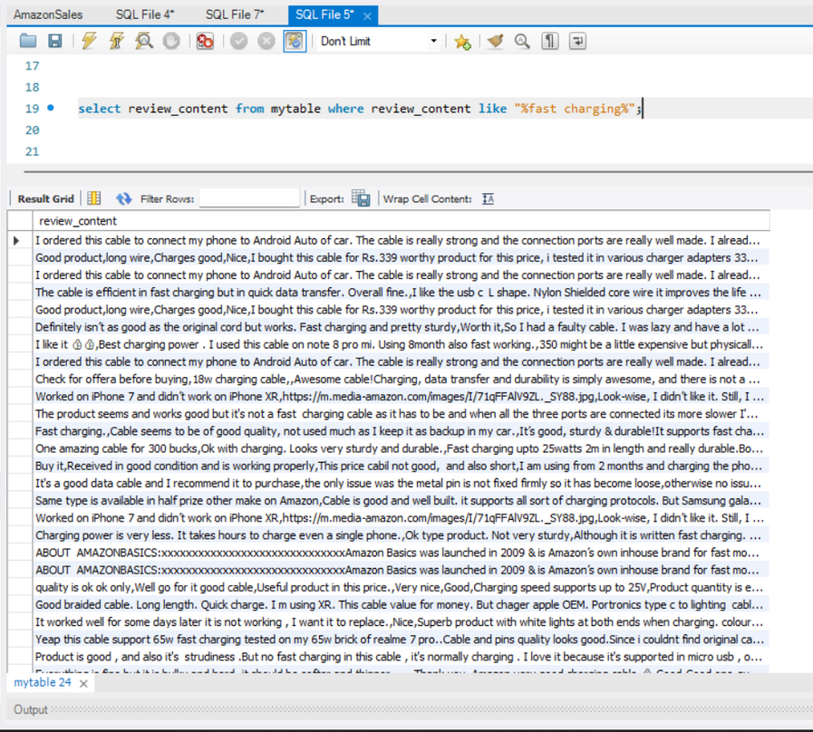
07
5. Query reviews that mention
"fast charging" in their content.
select review_content from mytable where review_content like "%fast charging%";

Slide 9
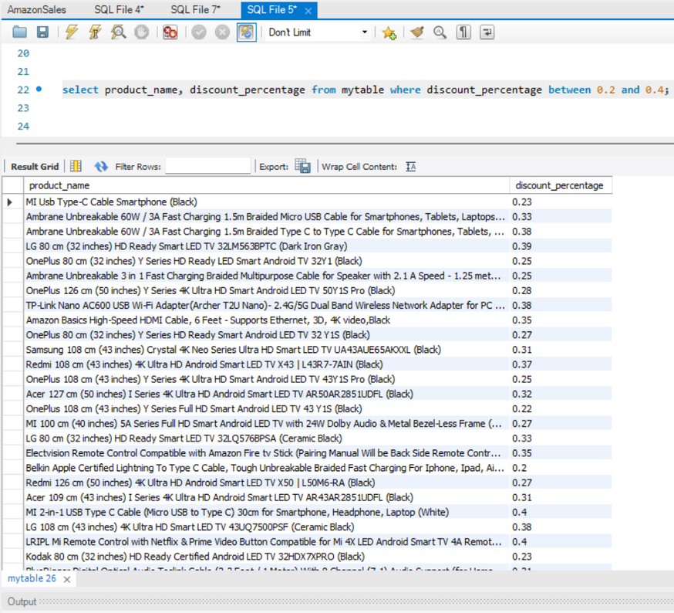
6.Identify products with a discount percentage between 20% and 40%.
08
select product_name, discount_percentage from mytable where discount_percentage between 0.2 and 0.4;

Slide 10
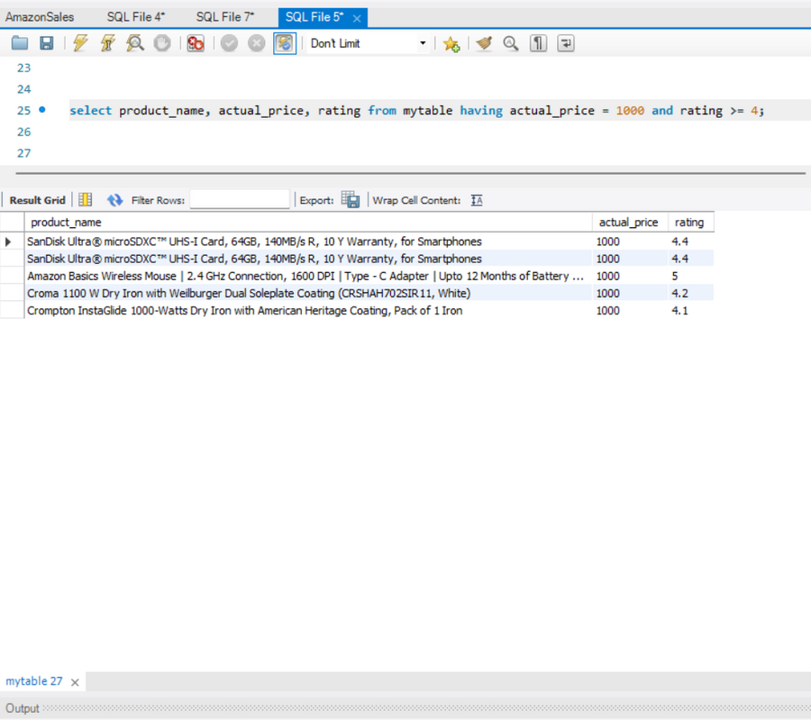
7.Find products that have an actual price above ₹1,000 and are rated 4 stars or above.
select product_name, actual_price, rating from mytable having actual_price = 1000 and rating >= 4;

Slide 11
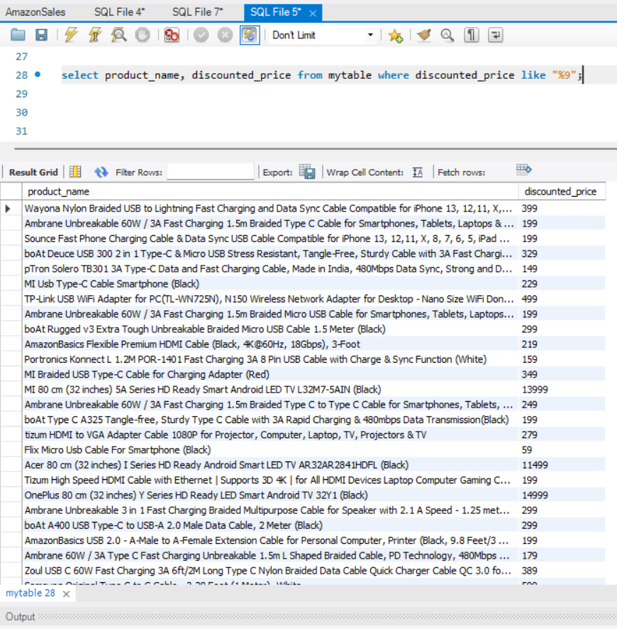
10
8.Find products where the discounted price ends
with a 9.
select product_name, discounted_price from mytable where discounted_price like "%9";

Slide 12
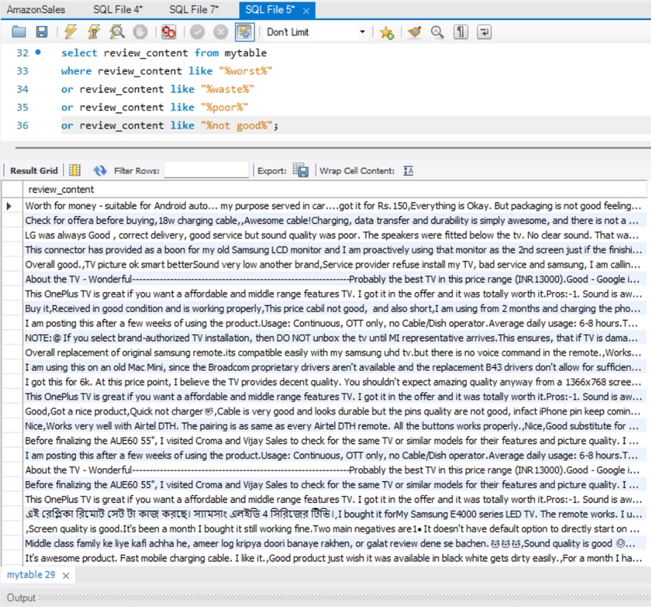
9.Display review contents that contains words like worst, waste, poor, or not good.
11
select review_content from mytable
where review_content like "%worst%"
or review_content like "%waste%"
or review_content like "%poor%"
or review_content like "%not good%";

Slide 13
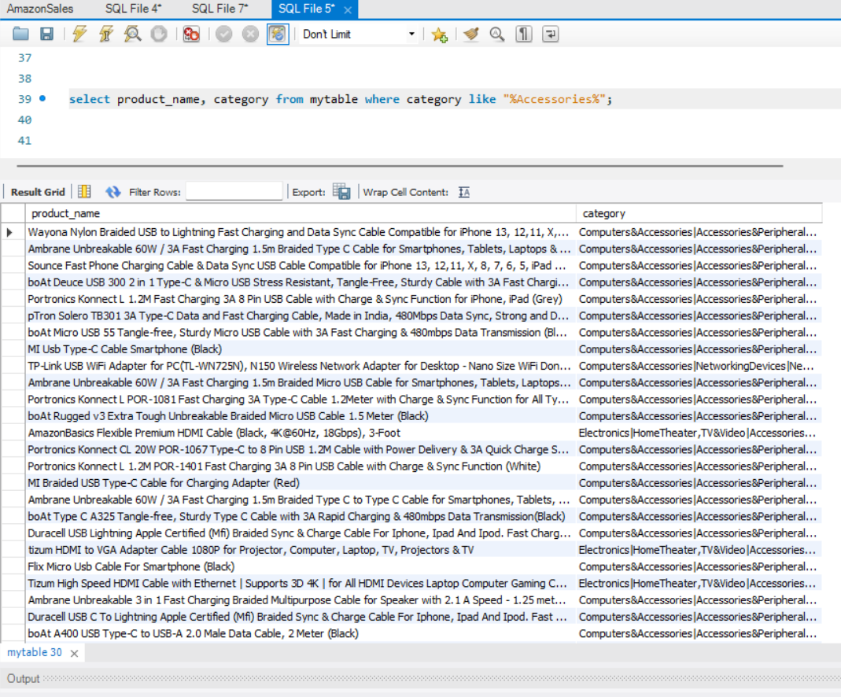
10.List all products where the category includes "Accessories."
12
select product_name, category from mytable where category like "%Accessories%";

Slide 14

🚀 Amazon Sales Data Analysis: Leveraging SQL for E-Commerce Insights 🛒📊
As part of my data analytics journey, I explored Amazon’s sales data using SQL, uncovering key patterns in pricing, customer reviews, and product discounts.
Here’s what I found:
🔹 Product Pricing & Discounts
Identified products with high discounts (50% or more) for strategic promotions.
Analyzed price differences between actual and discounted prices.
Found discounted products under ₹500, catering to budget-conscious customers.
🔹 Customer Reviews & Feedback
Extracted reviews mentioning "fast charging" to assess product performance.
Flagged negative sentiment reviews containing words like "worst" and "poor."
🔹 Product Category & Trends
Listed top-rated products (4+ stars) with premium pricing above ₹1,000.
Found popular accessories using category-based filtering.
Identified products ending in ₹9, a common psychological pricing strategy.
📌 Key Takeaways
✔ SQL-driven insights help optimize pricing strategies and discounts.
✔ Customer sentiment analysis can enhance product quality and service.
✔ E-commerce brands can leverage data to improve sales and engagement.
💡 Data analytics continues to shape the future of e-commerce, making businesses more data-driven and customer-centric!

Slide 15
THANK YOU!

